Slide 1



Decentralized Social Network using Blockchain (Dinke-Din)
Supervised By
Mohammad Sazid Zaman Khan
Lecturer
Department of CSE, IIUC
Presented By
Jamshedul Alam - C171029
Mohammed Raihan - C163069

Slide 2
Background
The New York Times reported in March 2018 that a business fraudulently got information from more than 50 million Facebook users .
In the last decade, dozens of media companies, ranging from prestigious publications like the Washington Post to social media platforms like Facebook, have seen customers’ and the companies’ private data exposed.

Slide 3
Blockchain Decentralized Website
Brave browser enable decentralized web.
Patient Centric Image Management.
Tweetchain
Traffic Police Assistant system.
Secure Research record keeping.
HealthSense

Slide 4
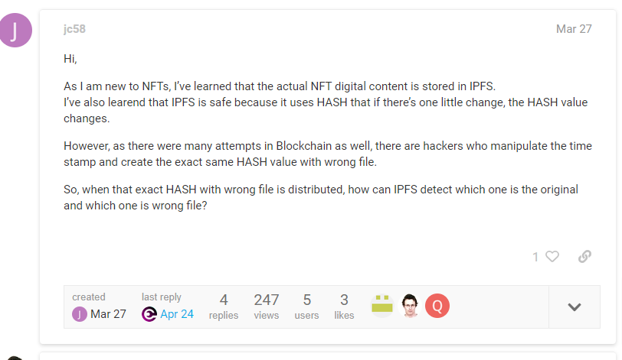
Problem Statement

Slide 5
HTTP request would look like this
http://10.20.30.40/user/post/image
IPFS request would look like
https://ipfs.io/ipfs/Qmbev52icDQtBMozC7pbuqxKEtPvnw3473EGkuDfhXeGLw?filename=Image%201.png

Slide 6
Literature Review
SL No. | Name | Descriptions | Limitations
3 | IdM system | based on Single Sign-On services . SP validates the identity and credentials with an Idp , preventing the user needs to enter it’s identifier and password to access the services.. | It left authentication layer risky.

Slide 7
SL No. | Name | Descriptions | Limitations
3 | Medical Image Sharing system | Blockchain based image sharing system . It also offers data encryption features. Since each transaction requires peer-to-peer verification. | It has no strong auhentication system .

Slide 8
SL No. | Name | Descriptions | Limitations
3 | Fast Image encryption system . | uses the permutation and diffusion to encrypt the image .they used permutation algorithms including sorting-based permutation algorithm .They emphaiss on using of parrallelism of diffusion to get quality full result on image encryption . | i .

Slide 9
Research Gap
Most of the applications have Complexity in using Image encryption and decentralization the system
They have limitations in combining authentication and Blockchain in same system
Most of the system are mainly focused on providing a secure system on their own system

Slide 10
Objectives
Protecting User Account
To keep personal data access as secure as possible.
To store all resources in a separate cloud storage, the OSN will communicate with that cloud storage to retrieve the desired data based on the user's rights and public key

Slide 11
Methodologies
WE CHOOSE SPIRAL MODEL (SDM)
Why?
risk and costs evaluation is important
When changes may require at any time
When long term project commitment is not feasible due to changes in economic priorities

Slide 12
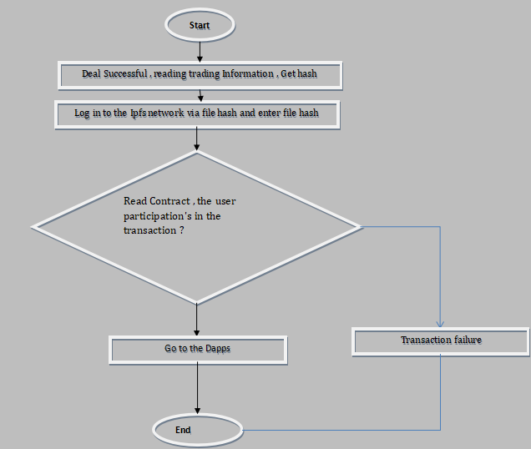
flowchart of Dinke-din

Slide 13
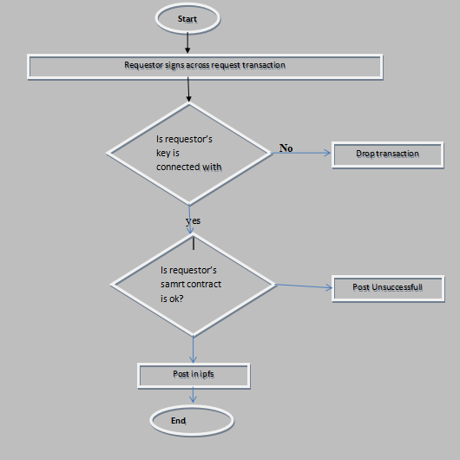
Flow Chart Diagram for User Posting

Slide 14
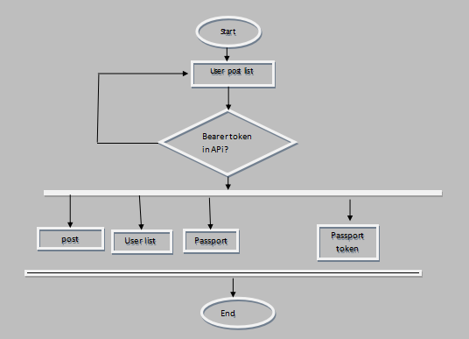
Flow Chart Diagram for Admin Panel

Slide 15
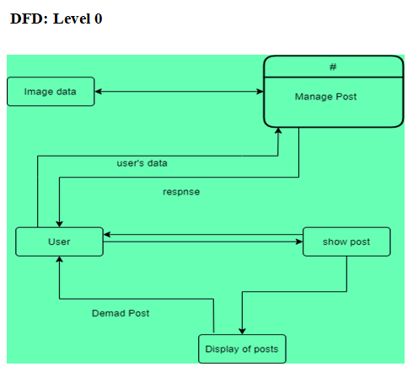
Data Flow Diagram of Security Module

Slide 16
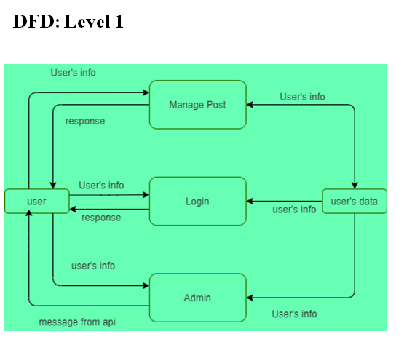
Data Flow Diagram of Security Module

Slide 17
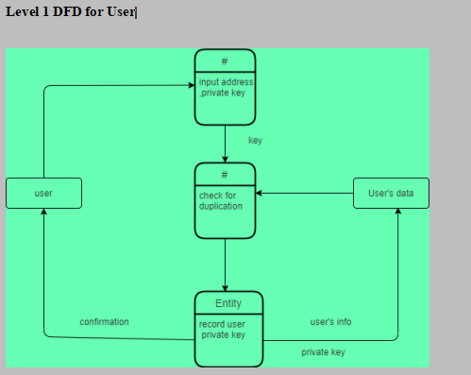
Data Flow Diagram of Security Module

Slide 18
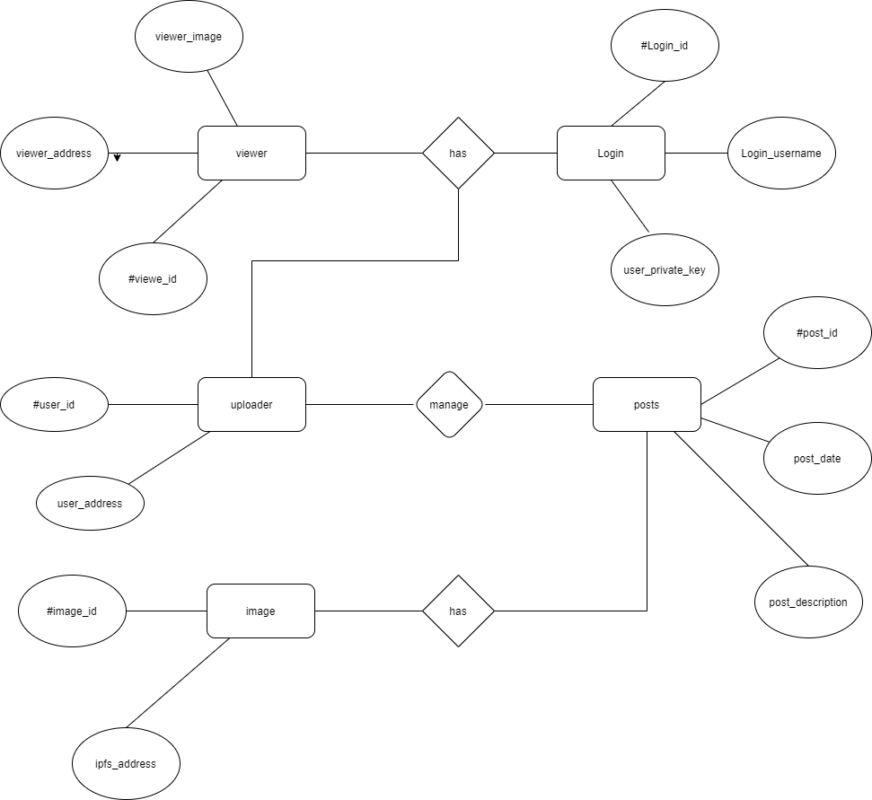
Entity Relationship Diagram

Slide 19
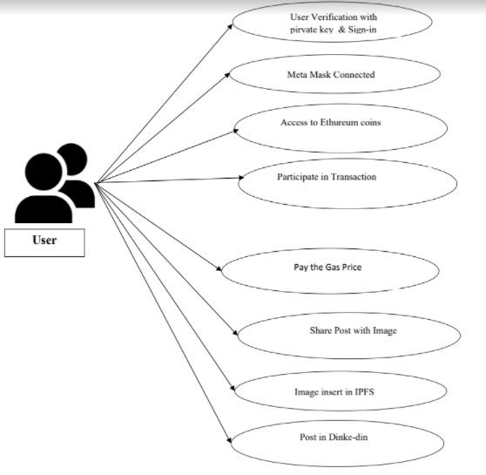
Use Case Diagram for dinke-din

Slide 20
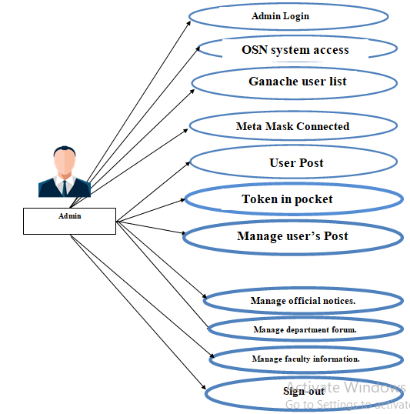
Use Case Diagram for Admin

Slide 21
Frontend tools
React js(open-source front-end JavaScript library for building user interface on UI components).
Material UI(Customizable , accessiible library of React Components)
Bootstrap (the world’s most popular front-end open source toolkit.)

Slide 22
Backend tools
Laravel ()
Solidity
Ganache
MetaMask

Slide 23
Feature-based outcomes from your project

Slide 24
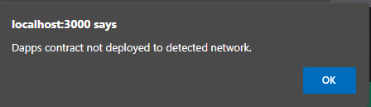
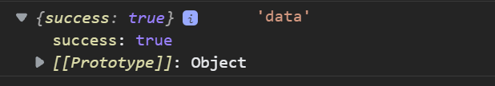
Testing results

Slide 25
 | Output | Expected Result
posts?id=`id`-10 | As we send Get Method to the api back-end , it give us error . | As there is no such routes in our system it should return a routes error.

Slide 26
Discussion
In our Dinke-din we are going to explore the Blockchain world so that in social network uses can be safe and it’s owner can keep the data in safe.
We all are familiar with sharing post to social media .We all feel insecure about data that we are sharing to the online social network (OSN) system.What will happen to our life if any of the data are hacked or modified or shared to any corrupt person .
Then our daily life's becomes a hard one to live .Dinke-din is the place where we explore the Blockchain and it’s most eye charming technology IPFS( Inter Planetary File system ). In the Dinke-din , we used the Blockchain hash ,the most buzzing word we always listen to secure the data , is like fingerprint for digital data [17]. In our Dinke-din we uses different hashing algorithm.

Slide 27
contribution of the work
Blockchain helps to solve the security problem about user’s shared data and user data. But we make a separate cloud system where we stored the ipfs returned hash value in database
.In this cloud system whenever a user post in our Dinke-din , this post account address , image ipfs hash address , description of the post and date of the post will be stored in the database .
The most interesting thing about that is that it is a place for user and owner of Dinke-din .Here if any party want the post data or user data he must have to bearer token in his hand , without that he will be detected as a evil user.

Slide 28
Conclusions
. Our Dinke-din is a solution to the social network data losing and data corruption .
In Dinke-din , we try to solve the most debating talk we always have with each other about what we sharing in the Dinke-din is it safe?
Will Dinke-din Owner share the all user data and user info to the thrid party ?
To solve this problem in our Dinke-din we uses IPFS Blockchain system

Slide 29
References
[1] Pawade, Dipti, and Avani Sakhapara. "Blockchain Based Secure Traffic Police Assistant System." (2020).
[2] Sultana, Maliha, et al. "Towards developing a secure medical image sharing system based on zero trust principles and Blockchain technology." BMC Medical Informatics and Decision Making 20.1 (2020): 1-10.
[3] Adriano Witkowski and Altair Santin “An IdM and Key-Based Authentication Method for Providing Single Sign-On in IoT ”.
[4] R. Mehta, N. Kapoor, S. Sourav and R. Shorey, "Decentralised Image Sharing and Copyright Protection using Blockchain and Perceptual Hashes," 2019 11th International Conference on Communication Systems & Networks (COMSNETS), 2019, pp. 1-6, doi: 10.1109/COMSNETS.2019.8711440. Jabarulla, Mohamed Y., and Heung-No Lee. 2021. "Blockchain-Based Distributed Patient-Centric Image Management System" Applied Sciences 11, no. 1: 196. https://doi.org/10.3390/app11010196

Slide 30
[6]Kumar, Randhir, et al. "A secured distributed detection system based on IPFS and Blockchain for industrial image and video data security." Journal of Parallel and Distributed Computing 152 (2021): 128-143.
[7]Zhang, Lei, Mingxing Luo, Jiangtao Li, Man Ho Au, Kim-Kwang Raymond Choo, Tong Chen, and Shengwei Tian. "Blockchain based secure data sharing system for Internet of vehicles: A position paper." Vehicular Communications 16 (2019): 85-93.
[8]Feixiang, Zhao, Liu Mingzhe, Wang Kun, and Zhang Hong. "Color image encryption via Hénon-zigzag map and chaotic restricted Boltzmann machine over Blockchain." Optics & Laser Technology 135 (2021): 106610.
[9]Wang, Xingyuan, Le Feng, and Hongyu Zhao. "Fast image encryption algorithm based on parallel computing system." Information Sciences 486 (2019): 340-358.
[10]Laiphrakpam, Dolendro Singh, and Manglem Singh Khumanthem. "Medical image encryption based on improved ElGamal encryption technique." Optik 147 (2017): 88-102.

Slide 31
[11]Cai, Lu-Zhong, Ming-Zhao He, Qing Liu, and Xiu-Lun Yang. "Digital image encryption and watermarking by phase-shifting interferometry." Applied optics 43, no. 15 (2004): 3078-3084.
[12]Zhou, Yuezhi, Yaoxue Zhang, and Yinglian Xie. "Virtual disk based centralized management for enterprise networks." In Proceedings of the 2006 SIGCOMM workshop on Internet network management, pp. 23-28. 2006.
[13]Mohsin, A. H., A. A. Zaidan, B. B. Zaidan, K. I. Mohammed, Osamah Shihab Albahri, Ahmed Shihab Albahri, and M. A. Alsalem. "PSO–Blockchain-based image steganography: towards a new method to secure updating and sharing COVID-19 data in decentralised hospitals intelligence architecture." Multimedia tools and applications 80, no. 9 (2021): 14137-14161.
[14]Bhowmik, D., Natu, A., Ishikawa, T., Feng, T., & Abhayaratne, C. (2018, July). The Jpeg-Blockchain framework for glam services. In 2018 IEEE International Conference on Multimedia & Expo Workshops (ICMEW) (pp. 1-6). IEEE.

Slide 32
[16] Swapnil Ninawe and Pallapa Venkataram “Authentication schemes for social network users: a review ”.
[17]What is Blockchain ? what is the future of it 8 Reasons Why Blockchain Technology Is the Future | upGrad blog
[18] Zheng, Qiuhong, Yi Li, Ping Chen, and Xinghua Dong. "An innovative IPFS-based storage model for blockchain." In 2018 IEEE/WIC/ACM International Conference on Web Intelligence (WI), pp. 704-708. IEEE, 2018.
[19]Kozlowska, Iga. "Facebook and data privacy in the age of Cambridge Analytica." Seattle, WA: The University of Washington. Retrieved August 1 (2018): 2019.
[20]What is testing What is software testing? - Quora

